Slide 1
Power electronic an drives: ELEC 2208 – 4
Chapter 1: Electromagnetic and Mechanical Fundamentals
Dr Frederic Gardes
University of Southampton
2019-2020s

Slide 2
Overview
Chapter 1 covers the following basic definitions:
Moment of inertia
Friction
Path control
Power transmission
Torque balanced equation
Torque and kinetic energy
Exemples of connectors
Transducers

Slide 3
Overview
Chapter 1 covers the following basic definitions:
Transducers
Introduction
Overview
Specifying
Errors
Rotating Velocity Transducers
Overview
Brushed Tachogenerator
Incremental System
Position Transducers
Non-optical
Optical
Installation

Slide 4
Introduction
Typical systems

Slide 5
Introduction
Key Points
In a closed-loop control system, feedback is used to minimise the difference between the demanded and actual output.
In a motion-control system, the controlled variable is typically velocity or position.
The overall performance of a motion-control system will depend, to a large extent, on the type and quality of the transducer which is used to generate the feedback signal.

Slide 6
Introduction
Characteristics of a transducer
Accuracy
Dead band
Drift
Linearity
Repeatability
Resolution
Sensitivity

Slide 7
Introduction
Characteristics of a transducer - 1
Accuracy is a measure of how the output of the transducer relates to the true value at the input.
The value needs to be qualified by a statement of which errors are being considered
Provide the conditions under which they occur.
Dead band is the largest change in input to which the transducer will fail to respond; this is normally caused by mechanical effects such as friction, backlash, or hysteresis.

Slide 8
Introduction
Characteristics of a transducer - 2
Drift is the variation in the transducer's output which is not caused by a change in the input; typically, it is caused by thermal effects on the transducer or on its conditioning
system.
Linearity is a measure of the consistency of the input/output ratio over the useful range of the transducer.
Repeatability is a measure of the closeness with which a group of output values agree for a constant input, under a given set of environmental conditions.

Slide 9
Introduction
Characteristics of a transducer - 3
Resolution is the smallest change in the input that can be detected with certainty by the transducer.
Sensitivity is the ratio of the change in the output to a given change in the input. This is sometimes referred to as the gain or the scale factor.

Slide 10
Introduction
High Repeatability and...
....Low Accuracy
....High Accuracy

Slide 11
Introduction
Low Repeatability and Low Accuracy

Slide 12
Introduction
Resolution
Coarse resolution

Slide 13
Introduction
Resolution
Coarse resolution
Fine resolution

Slide 14
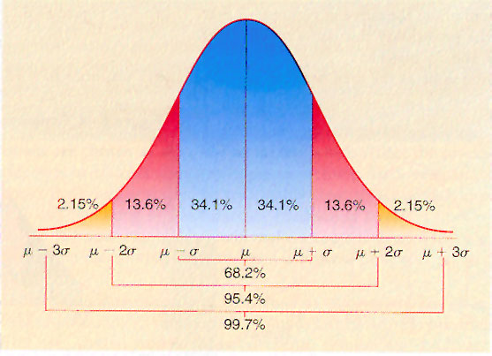
Introduction
Random Errors - 1
If a large set of data is taken from a transducer under identical conditions, and if the errors generated by the measurement system are random, the distribution of values about the mean will be Gaussian.
In this form of distribution, 68% of the readings lie within 1 standard deviation of the mean and 95% lie within 2 standard deviations.

Slide 15
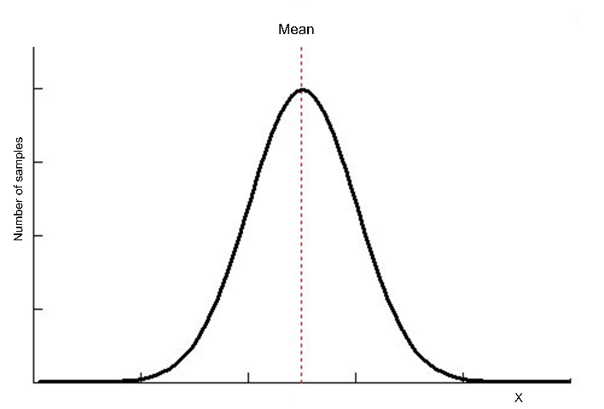
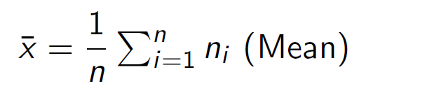
Introduction
Random Errors - 2
If a sample of n readings are taken with value x1, x2, x3, …. Xn, the mean is given by
The mean value is dependant of the number of samples taken and on the spread.
The true mean value would require an infinite amount of point and therefore cannot be determined.

Slide 16
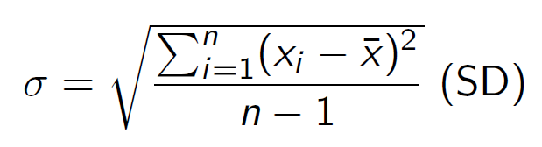
Introduction
Random Errors - 2
The standard error of the mean:
Enables to estimate the probability of how close the mean of a set of data is to the true mean of the system.

Slide 17
Introduction
Systematic Errors - 1
By taking a large number of samples, the random errors can be reduced to a very low value.
A systematic error occurs when all the measurements are shifted in one direction by an equal amount.
A measurement is accurate if the systematic error is small, and it is precise if the random error is small.

Slide 18
Introduction
Systematic Errors -

Slide 19
Introduction
Digital Errors - 1
Increasing reliance on digital-control techniques in drive systems. Digital controllers require the transducer's output to be sampled and digitised.
The actual process of sampling will introduce a number of errors of its own.

Slide 20
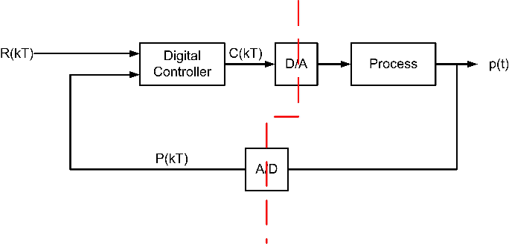
Introduction
Digital Errors - 2
Reference signal, R(kT), a feedback signal, P(kT), and the resultant value, C(kT), are discrete signals, the output, p(t) is a continuous function of time.

Slide 21
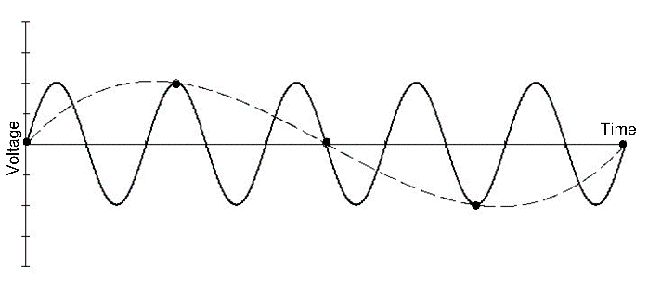
Introduction
Digital Errors - 3
The sampling frequency is largely determined by the loop time of the control system; a high sample rate will place restrictions on the complexity of the algorithms that must be employed. If the highest frequency present in the signal to be sampled is fp, then the minimum sampling rate is 2fp as defined by Shannon's sampling

Slide 22
Introduction
ADC and DAC Errors - 1
Conversion of an analogue signal to a digital value involves the process of quantisation.
In an analogue-to-digital (A/D) converter, the change from one state to the next will occur at a discrete point - the intermediate values are not considered.

Slide 23
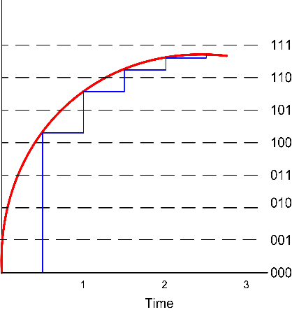
Introduction
ADC and DAC Errors - 1
Analog Signal
Digital Signal
Sample and hold

Slide 24
Introduction
ADC and DAC Errors - 1
Sample and hold
DAC output

Slide 25
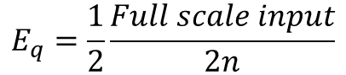
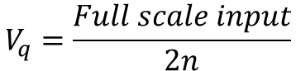
Introduction
ADC and DAC Errors - 3
The difference between any two digital values is known as the quantisation size, Vq, and it is commonly termed as the resolution of the converter.
For an n-bit system the steps due to quantisation, Vq, and the subsequent error Eq are equal to:
$$V_{q}=\frac{Full scale input}{2n}$$
$$E_{q}=\frac{1}{2}\frac{Full scale input}{2n}$$

Slide 26
Introduction
Dynamic Performance Errors - 1
The dynamic performance of the measurement system has to be considered.
A transducer with a linear characteristic will achieve a constant performance for all inputs.
This not true in a practical system, since the input will have a non-linear distortion caused by the transducer's frequency-dependent gain and the phase shift.

Slide 27
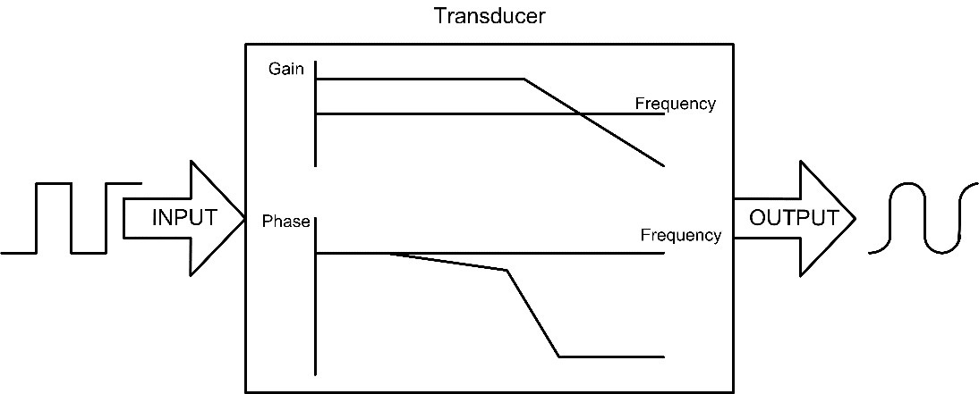
Introduction
Dynamic Performance Errors - 1

Slide 28
Introduction
Dynamic Performance Errors - 3
The dynamic performance needs to be considered in the selection of any transducer; even if the speed or position changes slowly, to ensure that any transient effects are considered.
A limited bandwidth transducer will seriously limit the overall system bandwidth, and hence its ability to respond to transients (such as the application or removal of torque from the load).

Slide 29
Rotating Velocity Transducers
Rotating Velocity Transducers - Overview
Velocity is speed together with direction.
Velocity can be determined from position measurement
Transducers provide an output which is proportional to the velocity.

Slide 30
Rotating Velocity Transducers
Rotating Velocity Transducers - Overview
Velocity is speed together with direction.
Velocity can be determined from position measurement
Transducers provide an output which is proportional to the velocity.
Brushed tachogenerators
Incremental Systems

Slide 31
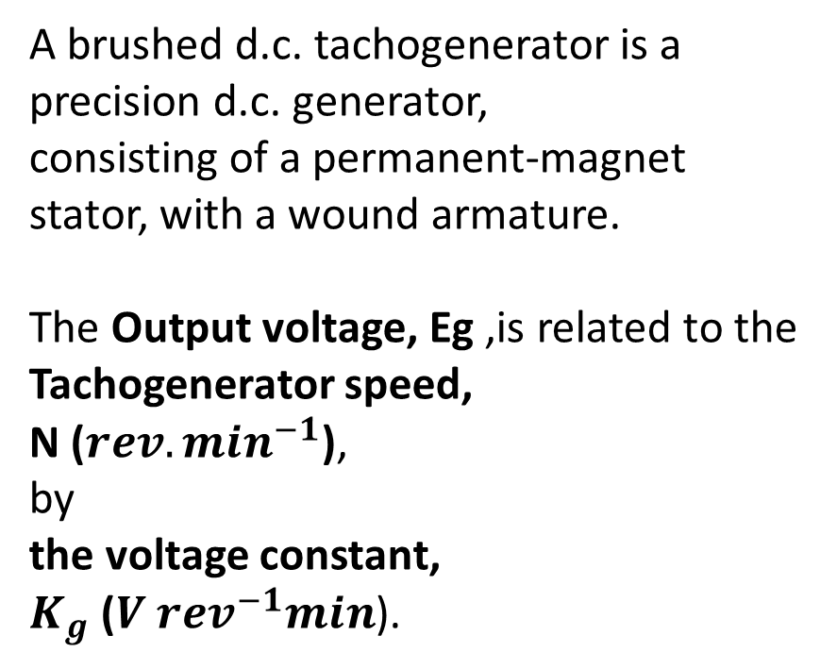
Rotating Velocity Transducers
Rotating Velocity Transducers - Overview
A brushed d.c. tachogenerator is a precision d.c. generator,
consisting of a permanent-magnet stator, with a wound armature.
The Output voltage, Eg ,is related to the Tachogenerator speed,
N ($rev.\min^{−1}$),
by
the voltage constant,
$K_{g}$ (${V rev}^{−1}min$).

Slide 32
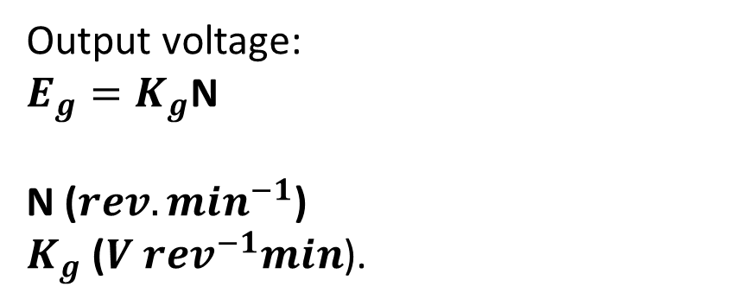
Rotating Velocity Transducers
Rotating Velocity Transducers - Overview
Output voltage:
$E_{g}=K_{g}$N
N ($rev.\min^{−1}$)
$K_{g}$ (${V rev}^{−1}min$).

Slide 33
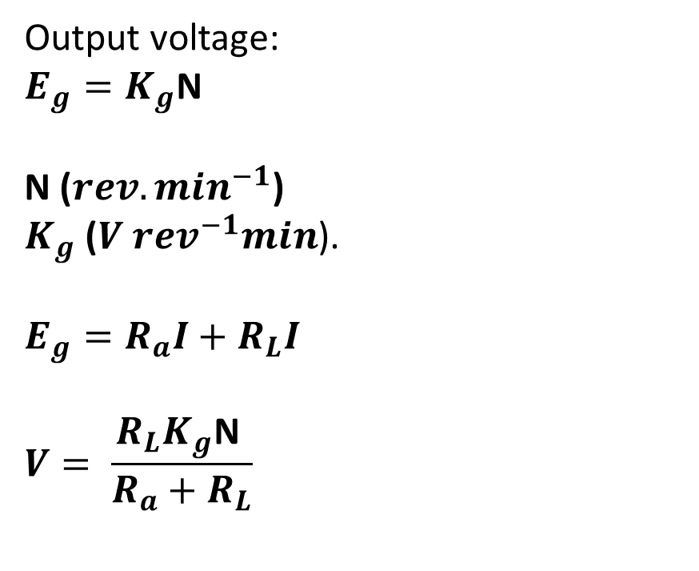
Rotating Velocity Transducers
Rotating Velocity Transducers - Overview
Output voltage:
$E_{g}=K_{g}$N
N ($rev.\min^{−1}$)
$K_{g}$ (${V rev}^{−1}min$).
$$E_{g}=R_{a}I+R_{L}I$$
$$V= \frac{{R_{L}K}_{g}\text{N} }{{R_{a}+R}_{L}}$$

Slide 34
Rotating Velocity Transducers
Brushed Tachogenerator - 3
A ripple-voltage component with a peak-to-peak value of five to six per cent of the output voltage is typical for brushed tachogenerators.

Slide 35
Rotating Velocity Transducers
Brushed Tachogenerator - 3
A ripple-voltage component with a peak-to-peak value of five to six per cent of the output voltage is typical for brushed tachogenerators.
Load resistance should be as large as possible to ensure that the terminal voltage is maximised;
however, the current which is drawn should be sufficiently high to ensure that the commutator surface does not become contaminated.(http://www.morganelectricalmaterials.com/media/1996/technicalhandbookglobalproof_0.pdf )

Slide 36
Rotating Velocity Transducers
Brushed Tachogenerator - 4

Slide 37
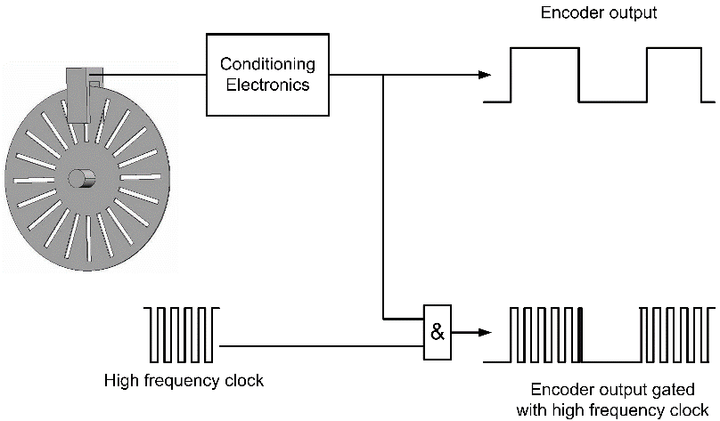
Rotating Velocity Transducers
Incremental Systems - 1

Slide 38
Rotating Velocity Transducers
Incremental Systems - 2
The frequency of the signal, and hence the speed of the shaft, can be measured by one of two methods.
Frequency can be measured, in the conventional fashion, by counting the number of pulses within a set time period.
Each half-cycle of the encoder output is gated with a high-frequency clock; the number of cycles which are enveloped is determined, and this value is used to calculate the shaft speed.
Note that even this method will prove difficult to use at very low speeds, because the number of high-frequency clock cycles per half-cycle becomes excessive.

Slide 39
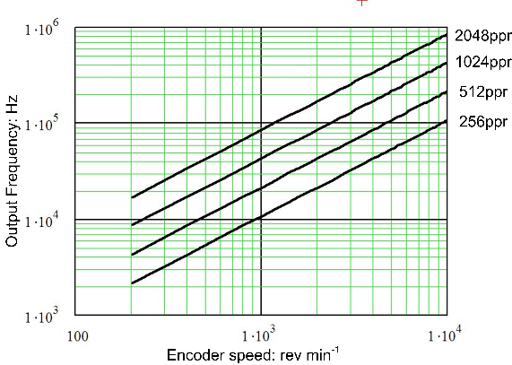
Rotating Velocity Transducers
Incremental Systems - 3
Frequency limitations as a function of ppr

Slide 40
Position Transducers
Position Transducers - Overview
Incremental: an encoder that produces a set number of pulses per revolution, which are counted to produce the positional information. If the power is lost, or the data is corrupted, rezeroing is required to obtain the true information.
Semi-absolute: An incremental encoder can be improved by the addition of a once-per-revolution marker; this will correct against noise in the system, but complete rezeroing will still be required after a power loss, because the counting of the number of revolutions is also lost.
Absolute: will maintain the zero and thus it will provide true
information despite a loss of power for any length of time.

Slide 41
Position Transducers
Potentiometer

Slide 42
Position Transducers
LVDT
Linear variable differential transformers
The operation is based on a transformer in which the coupling between the primary and secondary coils, is determined by the position of a movable ferromagnetic core.
The core is assembled using precision linear bearings to give low friction and wear. The most widely used design has a secondary winding which is split into two, on either side of the primary.

Slide 43
Position Transducers
LVDT

Slide 44
Position Transducers
LVDT - Operation

Slide 45
Position Transducers
LVDT - Operation

Slide 46
Position Transducers
LVDT - Processing

Slide 47
Position Transducers
LVDT - Application
Displacements from 1 mm to 600 mm in a variety of linearities and sensitivities.
Because there is no physical contact between the core and the coils, the main mechanical components of the LVDT will not degrade with use.
If precision bearings are used in the design, an almost infinite resolution, with zero hysteresis, is possible.
The small core size and mass, and the lack of friction, mean that LVDTs have a high-response capability for dynamic measurements.
LVDTs that are capable of operating in extreme environments, for example, ambient pressures up to 10⁷ Pa and temperatures up to 700C are not uncommon.

Slide 48
Position Transducers
Resolver

Slide 49
Position Transducers
Resolver
Resolvers are based on similar principles to LVDTs, but the primary winding moves relative to the two secondary windings rather than having a moving solid core.
As the relative positions of the primary and secondary windings change, the output varies as the sine of the angle.
By having two windings ninety electrical degrees apart and considering only the ratio of the outputs, the variations due to the input voltage and the frequency changes become unimportant.
The signals from the resolver are therefore relatively insensitive to an electrically noisy environment, and they can be transmitted over considerable distances with little loss in accuracy.

Slide 50
Position Transducers
Resolver - Internal construction

Slide 51
Position Transducers
Resolver - Wiring

Slide 52
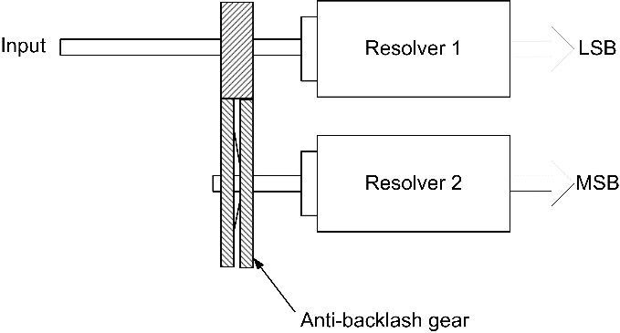
Position Transducers
Multi-turn Resolvers
Resolver is only absolute over one revolution
Solution is to couple two resolvers by a gear system so that the second resolver will rotate once for n turns of the input shaft.

Slide 53
Position Transducers
Inductosyn
Inductosyn is the trademark of a position transducer manufactured by Inductosyn International of Valhalla, New York.
Linear Inductosyns can be fabricated in lengths of up to 40 m, or they can be manufactured in a rotary form up to 0.5 m in diameter.
Inductosyns are inductively coupled, non-contact transducers, they are very tolerant to changes in the local dielectric constant; therefore, their operation will not be affected by dust, oil, or pressure changes in a hostile environment.

Slide 54
Position Transducers
Linear Inductosyn

Slide 55
Position Transducers
Inductosyn - Operation - 1

Slide 56
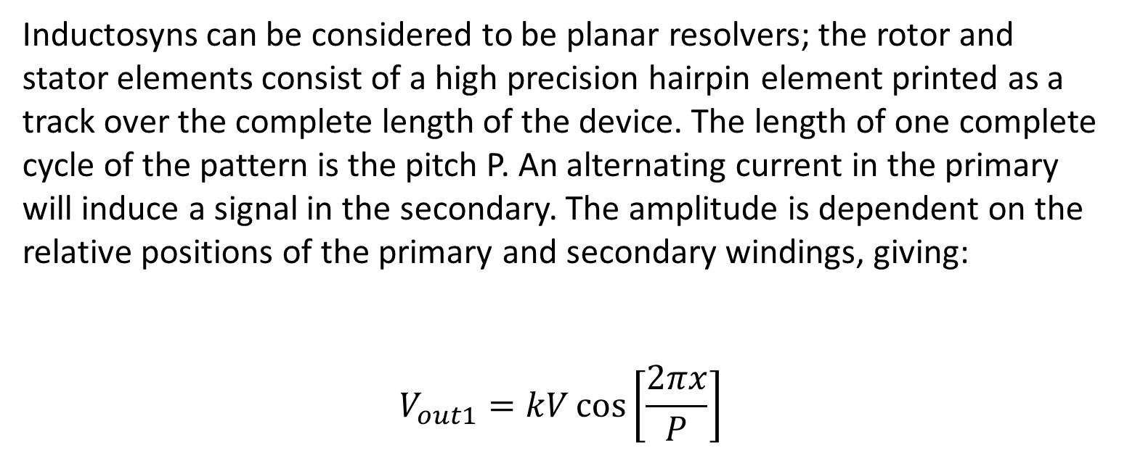
Position Transducers
Inductosyn - Operation - 2
Inductosyns can be considered to be planar resolvers; the rotor and stator elements consist of a high precision hairpin element printed as a track over the complete length of the device. The length of one complete cycle of the pattern is the pitch P. An alternating current in the primary will induce a signal in the secondary. The amplitude is dependent on the relative positions of the primary and secondary windings, giving:
$$V_{out1}=kV\cos\left[\frac{2πx}{P}\right]$$

Slide 57
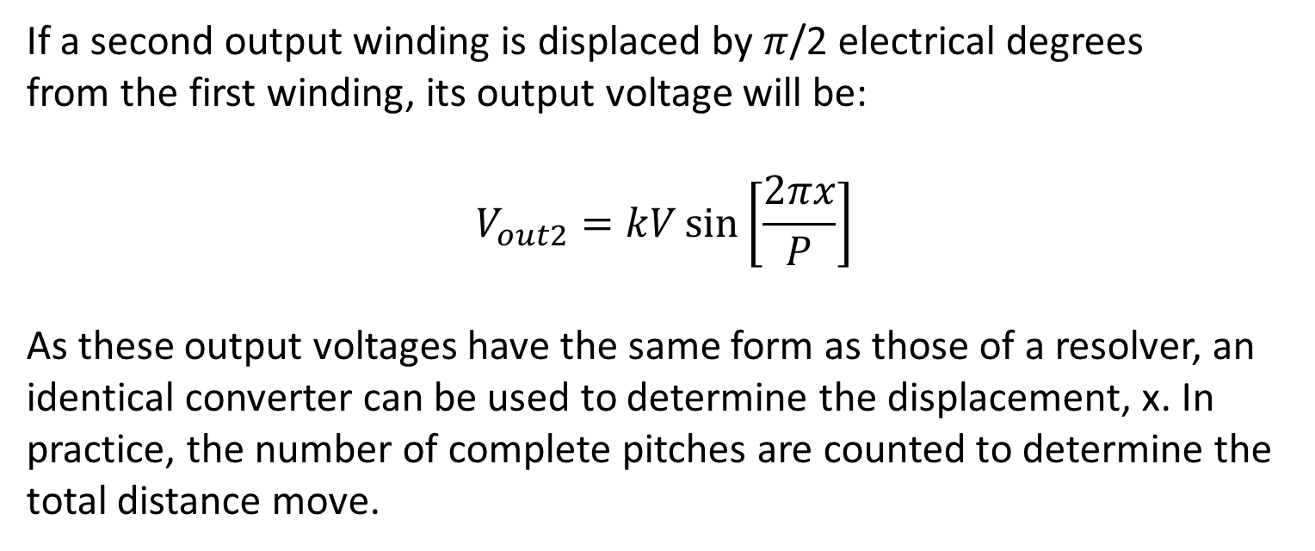
Position Transducers
Inductosyn - Operation - 2
If a second output winding is displaced by $π$/2 electrical degrees
from the first winding, its output voltage will be:
$$V_{out2}=kV\sin\left[\frac{2πx}{P}\right]$$
As these output voltages have the same form as those of a resolver, an identical converter can be used to determine the displacement, x. In practice, the number of complete pitches are counted to determine the total distance move.

Slide 58
Position Transducers
Optical position sensors
Optically based encoders are widely used for position measurements in robots and machine tools.
They can take one of three forms: absolute, semi-absolute, and incremental.
Each of these types of encoder consists of three elements: an optical receiver, a light source, and a code wheel.
The difference between the types of encoders is characterised by the information contained on the code wheel and by how it is interpreted by an external control system.

Slide 59
Position Transducers
Varients
Optical encoders can be supplied in a number of different formats
With integral bearings
Simple to mount
Sealed
Hollow shaft
Without integral bearings
Supplied as a kit of parts
Large diameter hollow shaft
Aligned during assemble

Slide 60
Position Transducers
Absolute Optical Encoder - 1

Slide 61
Position Transducers
Absolute Optical Encoder - 2
Absolute optical encoders incorporate a code wheel that is encoded in binary, either in pure binary or in grey code, with one bit per track.
The latter is preferred because only one bit changes between any two states. This prevents errors, since there is no way of guaranteeing that all the bits will change simultaneously at the boundary between two states, due to inherent manufacturing problems with the code wheel.

Slide 62
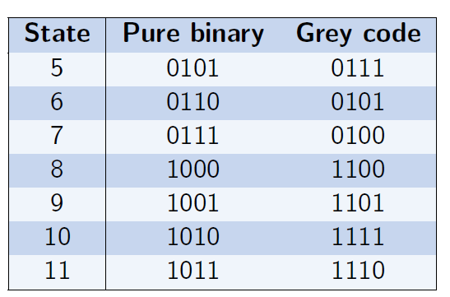
Position Transducers
Binary v Grey Code

Slide 63
Position Transducers
Semi-Absolute and Incremental Encoders - 1
The construction of an incremental encoder is based on a code wheel which has a single track of equal-sized, opaque and translucent slots; and, as the wheel is rotated, an alternating signal is produced with a frequency which is proportional to the speed of rotation
Semi-absolute encoders are incremental encoders with an additional output giving one pulse per revolution.
As the resolution of the encoder increases, the use of physical slots in the code wheel will become unreliable; hence, use is made of gratings.

Slide 64
Position Transducers
Semi-Absolute and Incremental Encoders - 2

Slide 65
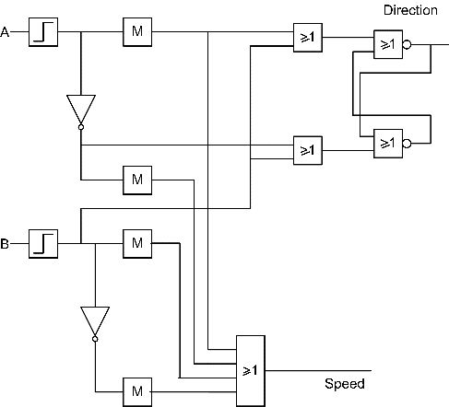
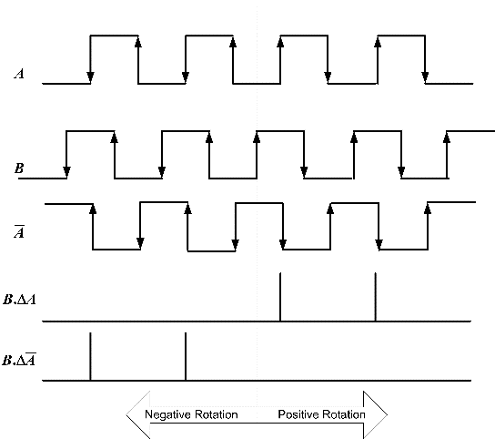
Position Transducers
Semi-Absolute and Incremental Encoders - 3

Slide 66
Position Transducers
Semi-Absolute and Incremental Encoders

Slide 67
Position Transducers
Linear Incremental Encoders - 1

Slide 68
Position Transducers
Linear Incremental Encoders - 2

Slide 69
Installation
Key Points
Optical encoders look robust but are relatively fragile
Shafts must be correctly aligned and coupled
Electrical connections must be of a high quality - noise can lead to false counts.

Slide 70
Installation
Encoder to motor

Slide 71
Installation
Linear

Slide 72
Installation
Switch Provision
To maintain correct operation of a drive system, and number of switches are provides.
Datum or home switch to provide a reference point for the measurement system.
Limit switch to prevent damage to the system.

Slide 73
Installation
Datum Switch: 1
Consider a lead screw with a semi-absolute encoder, the output of the encoder as a function of position is:

Slide 74
Position Transducers
Position Transducers - Overview
Incremental: an encoder that produces a set number of pulses per revolution, which are counted to produce the positional information. If the power is lost, or the data is corrupted, rezeroing is required to obtain the true information.
Semi-absolute: An incremental encoder can be improved by the addition of a once-per-revolution marker; this will correct against noise in the system, but complete rezeroing will still be required after a power loss, because the counting of the number of revolutions is also lost.
Absolute: will maintain the zero and thus it will provide true
information despite a loss of power for any length of time.

Slide 75
Installation
Datum Switch: 2
Addition of a datum switch

Slide 76
Installation
Datum Switch: 2
Output of the encoder and switch as a function of position.

Slide 77
Installation
Limit switches
In non-continuous rotating systems (e.g. leadscrew or linear drive) some method is required to prevent damage if the controller/programme tries to move the load past the end of the leadscrew or motors. This is the function of a LIMIT switch
Prevents the drive moving past a specific point.
Typically two options are available
Controller function (soft limit)
Hard wired into the drive - does not rely on software.

Slide 78
Installation
Typical drive interconnections

